Slide 1
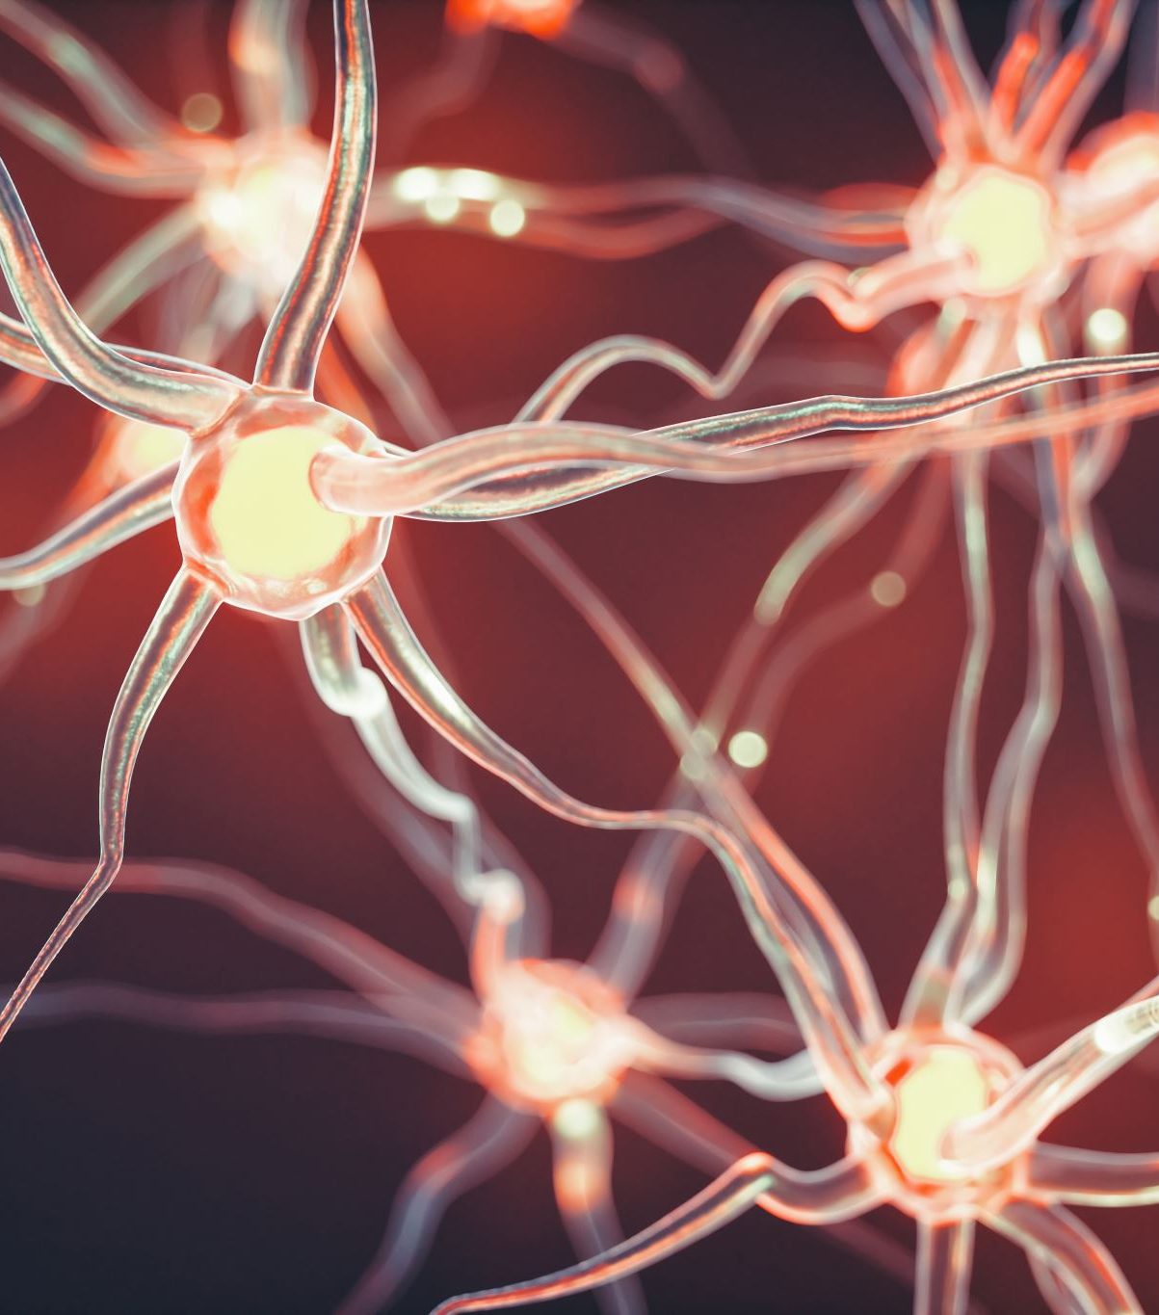
Effects of semantic associations and reward on hippocampal transitive inference processes
Florian Leprévost
Prof. Dr. Bianca Wittmann
Justus-Liebig-Universität Gießen –
BION meeting 2022

Slide 2
1.1 Associative Inference
1. Introduction
A
B
A
C
B
C
Notes:
What is AI

Slide 3
1.1 Associative Inference
1. Introduction
State representation
OFC (Spalding 18, Jones 12)
OFC-hippocampus (Bowman)
Value computation
Striatum & VTA dopamine (RL)
Generalisation
OFC hippocampus (Schlichting 16)
Striatum- hippo FC (Wimmer 12)
Dopamine to MTL? (Kahnt 16)
Semantic association (Ryan et al., 2016)
Facilitates associative learning
But not if hippocampus lesion
HPC
(associated) state computation
associated value computation
OFC
St
generalisation?
reinforcement learning
VTA
Notes:
what processes/areas involved

Slide 4

How does semantic memory facilitate associative learning?

Slide 5
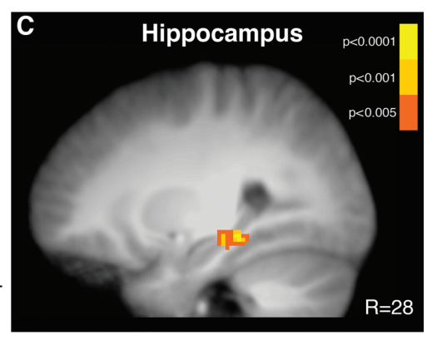
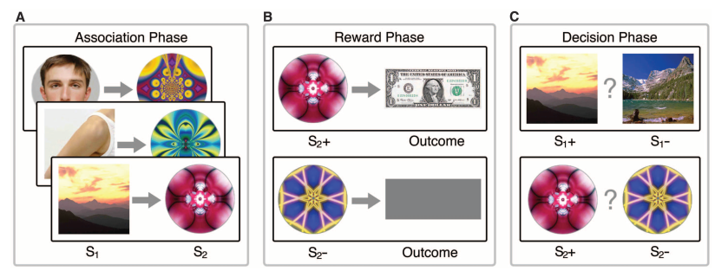
1.2 Paradigm
1. Introduction
Hippocampus activation during learning (A-B) predicts associative performance (in probe phase)
Wimmer & Shohamy 2012
Pre-conditioning Conditioning Probe
Less hippocampal involvement necessary for semantically linked pairs
Notes:
Example of xp based on this

Slide 6
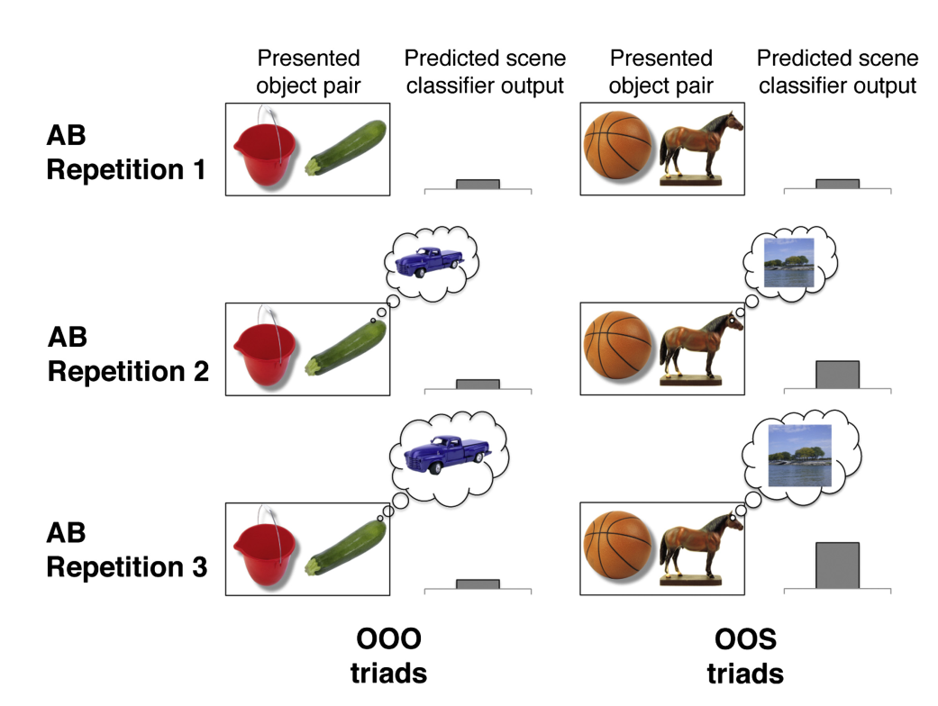
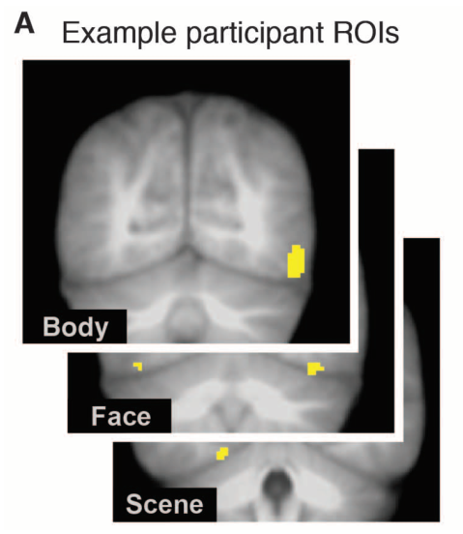
1.2 Paradigm
1. Introduction
Category specific visual areas
Train category classifier
Earlier greater classifier output for semantically linked objects

Slide 7
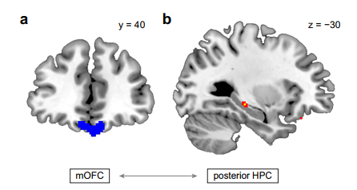
1.2 Paradigm
1. Introduction
OFC-hippo FC correls with reaction times during Probe phase (Wang)
Striatum- hippo FC during Conditioning phase correls with performance in Probe Phase (Wimmer)
Less hippocampal-OFC (and hippo-striatum) functional connectivity necessary for semantically linked pair

Slide 8
1. Introduction
1.3 Hypotheses
Hippocampal activity and connectivity reduced and unrelated to performance for semantically linked pairs
Reactivation of the associated stim in ealier repetition for the semantically linked pairs
+ candidates for semantic facilitation = IFG, entorhinal cortex, PCC

Slide 9

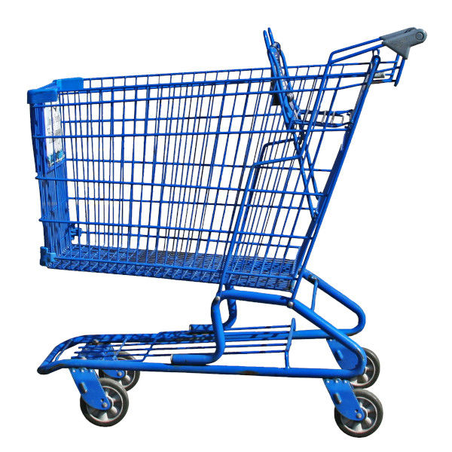
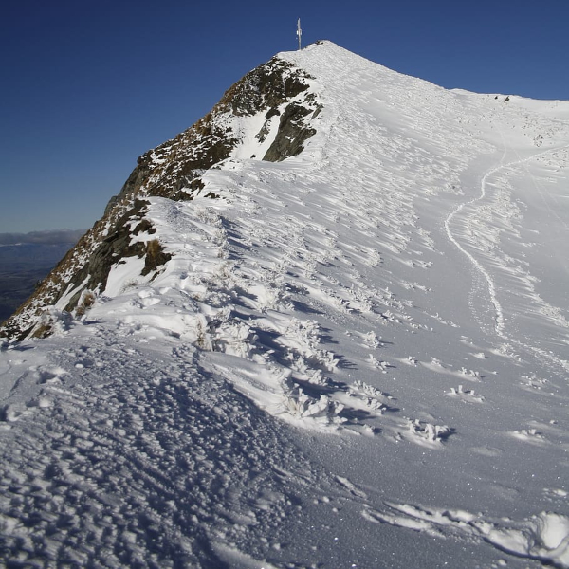
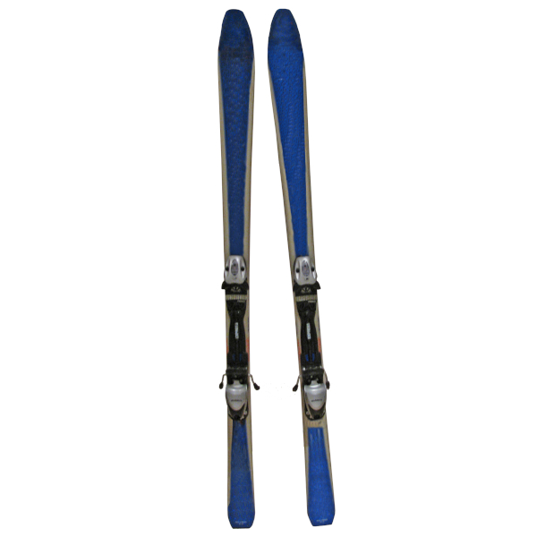

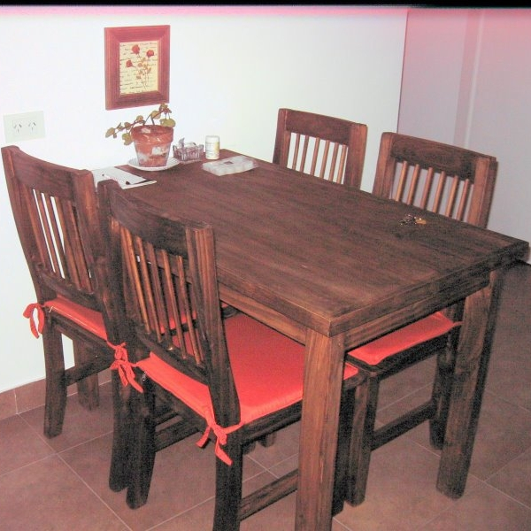

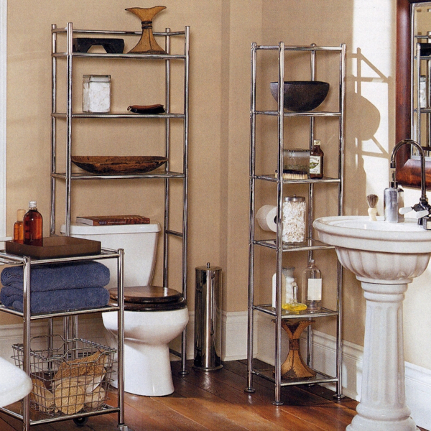
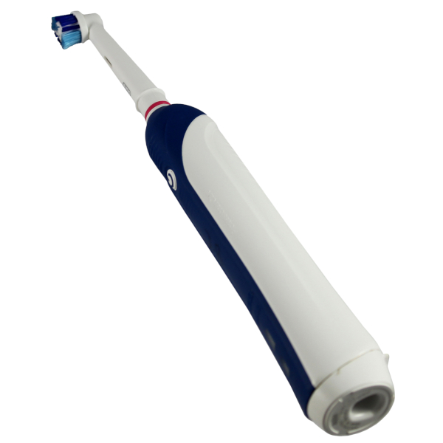

2.1 Design
2. Experiment
Semantic link
0 1
2 x 2
Semantic link
Reward
4 pairs of each = 16
Balanced
0
Reward
1

Slide 10
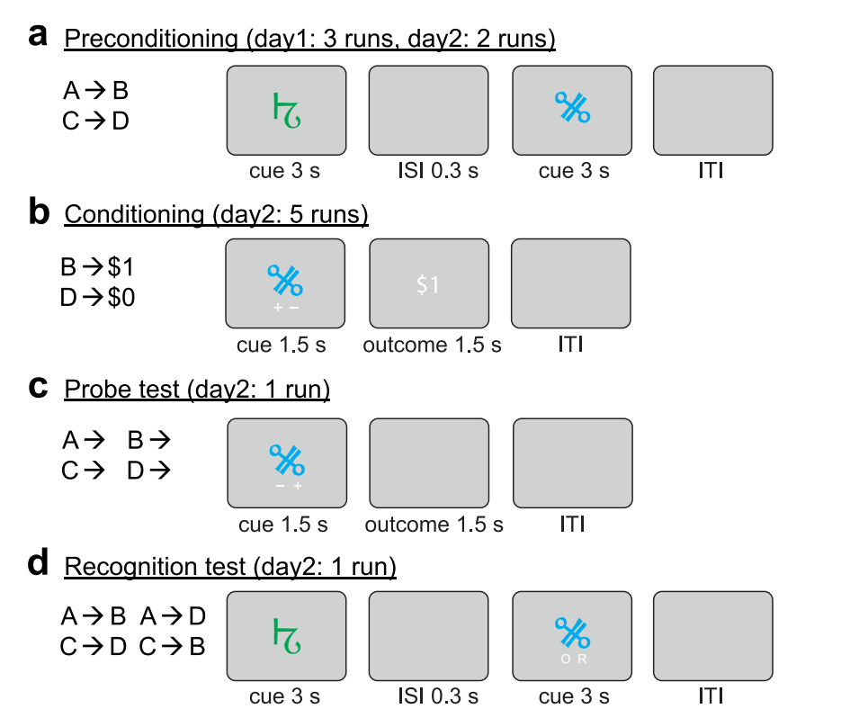
2.1 Design
2. Experiment
Pre-conditioning
Conditioning
Probe
Localizer
Distractor (avoid recency effects)
Memory
+ -
+ -

Slide 11

2. Experiment
2.2 Time course
Localizer
N-1 task 8 blocks of 13stims
Preconditioning
16 S-O pairs, 6 repetitions
Conditioning
16 O-R pairs, 6 repetitions
Distractor task
N-1 task 8 blocks of 13stims
Probe
32 single images, 2 repetitions
Memory
32 S-O pairs, ½ new, ½ old
~ 6 min
0,3s ITI + 2s stim
~ 7 min
S 1,5s + ISI 1s + O 1,5s + ITI 2,5s
~ 7 min
O 1,5s + ISI 1s + R 1,5s + ITI 2s
~ 6 min
#
~ 6 min
S1 1,5s + ISI 1s + O 1,5s + ITI 2s
~ 4 min
SO 2,5s + ITI 2s

Slide 12
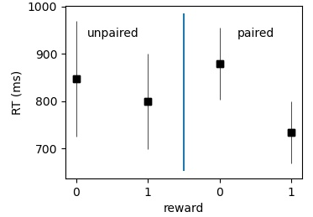
2. Experiment
2.3 Preliminary behavioral results
Semantic facilitation
n=4
Probe phase

Slide 13
3. fMRI
2.1 Sequence
nb of slices = 50
Slice thickness = 3mm
TE = 30ms
TR = 2,8s
voxel size = 3x3x3mm
iPAT grappa 2 factor

Slide 14
3. fMRI
2.2 Analyses
Regressors:
Phase
Stim onset
Contrast ANOVA 2x2
Classifiers – univariate & MVPA

Slide 15
3. fMRI
2.2 Analyses
For semantically linked pairs, is expected:
Earlier object decoding in scenes in preconditionning phase
Less link between:
hippocampal activity (and hippocampal-OFC connectivity) in first phases
& performance in last phase
To determine
Predictor of perf? RSA?
Earlier reactivation
Hippocampus only necessary for new association
Semantic processes
searchlight? ROIs?
Seed connectivity with striatum?

Slide 16
Preprocessing
Precond phase
2 for semantic = linked/unlinked
2 for state (A or B/ scene or object)
6 for each run
B. Cond phase
2 for semantic = linked/unlinked
2 for rewarded = rewarded/not
2 for reward stimulus
6 for each run
C. AC Inference phase
2 for semantic = linked/unlinked
2 for rewarded = rewarded/not
2 for each run
For most analysis within subject, no normalisation
Regressors of no interest
6 for head motion related activity
Regressor of interest
Convolved with onset and duration of each presentation (Wang 2020?)

Slide 17
1. Earlier/stronger reactivation 1.1 Multivariate classifier
Precond phase
Test Object (B) classifier on Scene (A) activity and see if B output increases, and if it increases differentially depending on semantic status (ANOVA 6*2 and t tests)
B. Cond phase
Test Scene (A) classifier on Object (B) activity and see if A output increases, and if it increases differentially depending on reward and semantic (ANOVA 6*2*2 and 6*4 and t tests)
C. AC Inference phase
Test if higher B (object) output for semantic link and/or reward (ANOVA 2*2 and t tests)
Test if B (object) output decrease with run (because direct association created)
Localizer training
2 classifier (SVM) trained on localizer data to recognize scenes and objects
On ventral temporal lobe ROI (mask from previous studies, Zeithamova 2012)
During 3 phases
Possible issue = circularity (each classifier trained on scenes vs objects => so negative weights of scenes classifier are the same as positive ones for the object classifier?

Slide 18
1. Earlier/stronger reactivation 1.2 Multivariate RSA
Precond phase
Correlation between 1) localizer object evoked pattern and 2) precond scene patterns * 6 runs * 2 semantic conditions
Regression (or anova 6*2) to see if repetition and semantic link predict higher correlation
B. Cond phase
Correlation between 1) localizer scene evoked pattern and 2) cond object patterns * 6 runs * 2 semantic conditions * 2 reward condition
Regression (or anova 6*4) to see if repetition, semantic link and reward predict higher correl
C. AC Inference phase
Correlation between 1) localizer object evoked pattern and 2) cond patterns * 2 runs * 2 semantic conditions * 2 reward condition
Regression (or anova 6*4) to see if repetition, semantic link and reward predict higher (or lower) correlation
Preparation
Average evoked activity to Scenes and Objects from localizer separately
On ventral temporal lobe ROI (mask from previous studies, Zeithamova 2012) – and potentially over ROIs
Correlate with average evoked activity in the next phase/runs/conditions
Pearson? (Wang, Schilchting)
Control = correlation between same category evoked pattern (eg localizer scene and precond scene) to make sure the effect is really related to reinstantiation of associated stimulus

Slide 19
1. Earlier/stronger reactivation 1.3 Multivariate classif specific
B. Cond phase
Test 16 scene classifiers on 16 associated objects
ANOVA 6*2*2 and t tests, to compare accuracy by run, by semantic, by reward condition
C. AC Inference phase
Test 16 object classifiers on 16 associated scenes
ANOVA 2*2*2 and t tests, to compare accuracy by run, by semantic, by reward condition
Preparation
32 classifiers to decode each object trained on the 6 preconditiong phase repetitions
Because the classifier needs to differentiate even associated stim, this should cancel somewhat the growing similarity between associated SO and within category
On ventral temporal lobe ROI (mask from previous studies, Zeithamova 2012) – and potentially over ROIs
NOT SURE IF ENOUGH TRAINING DATA AND IF NOT TOO CIRCULAR

Slide 20
1. Earlier/stronger reactivation 1.3 Multivariate RSA Specific
B. Cond phase
NOT SURE TOO POSSIBILITIES AND IMPLICATIONS
C. AC Inference phase
r
Preparation
Average evoked activity to specific stimuli from asso phase (eg averaged evoked response to the treadmill picture) separately for the 3 first and 3 last repetition = 7 patterns per SO pair
SP1, SP2, SI & OP1, OP2, OC1, OC2
On ventral temporal lobe ROI (mask from previous studies, Zeithamova 2012) – and potentially over ROIs

Slide 21
1. Earlier/stronger reactivation 1.1 Univariate
Precond phase
Activity from object mask for scenes increase across runs, faster and stronger if semantic link (ANOVA 6*2)
B. Cond phase
Activity from scene mask for objects increase across runs, faster and stronger if semantic link and reward (ANOVA 6*2*2)
C. AC Inference phase
Activity from object mask for scenes (increase across runs), faster and stronger if semantic link and reward (ANOVA (2*)2*2)
Define different ROIs (Wimmer 2012)
Contrast Scenes – Object from localizer
Include only voxels in the top 1% AND that fell within a group mask to define a SCENE mask and an OBJECT mask
Same contrasts during other phases
Average beta values within each mask; for each category (SO), each participant, each condition, each run, each phase
Normalize by average localizer activity within mask

Slide 22
2. Hippocampal involvement 2.1 Activity
Precond phase
8 values per categ (semantic/not)
T test = higher hippo for not semantic?
2 regression then t test = higher predictivity of perf for not sem?
Mediation ana?
B. Cond phase
Same but including reward
C. AC Inference phase
Same
Regressor activity in hippocampal mask, averaged by stimulus, by phase (maybe also runs?, or maybe focus on 1st 2 reps bc more hippo expected)
AC performance often almost 100% so maybe focus on RT

Slide 23
2. Hippocampal involvement 2.1 Connectivty
Precond phase
B. Cond phase
C. AC Inference phase
Not sure how to go because of design:
Remove all activity related to semantic pairs, then do seed analysis on remaining activty
Concatenate trials with Semantic stim together and do seed analysis on it (and same for non sem)

Slide 24
Other regions involvement
Contrast semantic pairs – non semantic pairs in every phase
(Also every combination with reward)
Searchlight RSA analysis to identify where similarity higher for semantic pairs

